Slide 1
project Miles
Team 8 | Project 1

Slide 2
The following slides with the green background are placeholders for our major presentation sections.
After that, you’ll find slide templates provided by Google slides, adjusted to fit our color scheme and branding, which you can copy and adapt to create your own slides. Or not.
Please insert your slides in between the respective placeholder slides. Feel free to adjust the wording of the section headings.
To use the templates below as starters you can either copy and paste chosen layouts into your section or click on Insert in the menu, then choose “New Slide” and you can select from different backgrounds..

Slide 3
What It Is
project description
Kaitlin Elisabeth Hulsy

Slide 4
Goals
MVP and Stretch goals for app development
Jen Jayme

Slide 5



In a nutshell...
Health for Teens. Gamified with Avengers.
Educate teens about exercise, nutrition and, eventually, mental health
Promote healthy choices for meals and activities
Make it fun and engaging for young people, ages 11-16

Slide 6

MVP Goals
Landing Page Attractive User-friendly Clear purpose, ways to interact
User Profile User can choose a Marvel character as their avatar. Local storage determines new user vs returning user on visit. DOM greets avatar with personalized text and simple image(s).
User Interactivity * Modals prompt users to choose Grab A Healthy Meal or Get Active * Users prompted to choose mode of travel, Input start/end address * Choices & locations saved to local storage.
Key Functions * App gives tips for local healthy meals, exercise, other health * Award points for healthy choices. * Score displayed and badges added to profile as score grows.

Slide 7
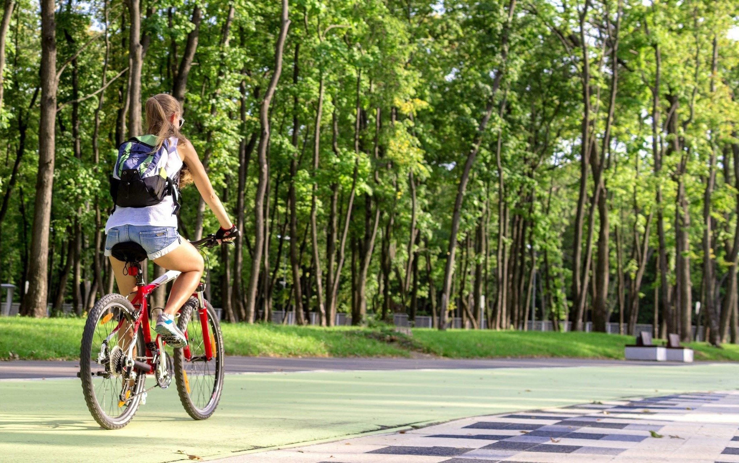
Stretch Goals
Leaderboard Scores of local users reflected on leaderboard.
Unlock New Characters Increased activity enables unlocking of new characters.
Challenges Users are presented with challenges both for characters and selves - e.g., health trivia and/or healthy actions.
Toggle Mode of Transport Users can see how different modes of transport (walk, bike, skateboard) return different points before choosing.
Help Me Find… Function App helps user find a nearby park, hike, bike trail, and start and end addresses returnrf to function that calculates points for exercise
Mental Health Add mental health tips and resources to exercise and nutrition.

Slide 8
User Stories & Wireframes
meet our target users
and their journey
Colin Whitcomb

Slide 9

Meet Brandon.
I don’t really like to exercise exactly, but I don’t mind if I get exercise while I’m getting somewhere I have to go anyway...
“I want to know how far away something is so I know if I can walk that far or if I should ride my bike instead.”
Earn Points for Biking to School
project Miles calculates the calories burned on the user’s trips to school, the library, the grocery store and to hang out with friends, and awards points for exercise on these routes.

Slide 10

Meet Nicole.
My friends and I go out to eat after school a lot. We want to eat healthy but we usually go to the first, closest place we can think of and order french fries. We might try new places if we had a fun way to find healthy meals nearby...
“I want to see restaurant options in my area so that I can choose the location with healthier choices.”

Slide 11

Meet Sam
I hang out at my friends’ house after school all the time. I usually get a ride from my mom, but I guess I could ride my bike or skateboard...
“I really love games. Project Miles makes exercising fun!”
project Miles

Slide 12
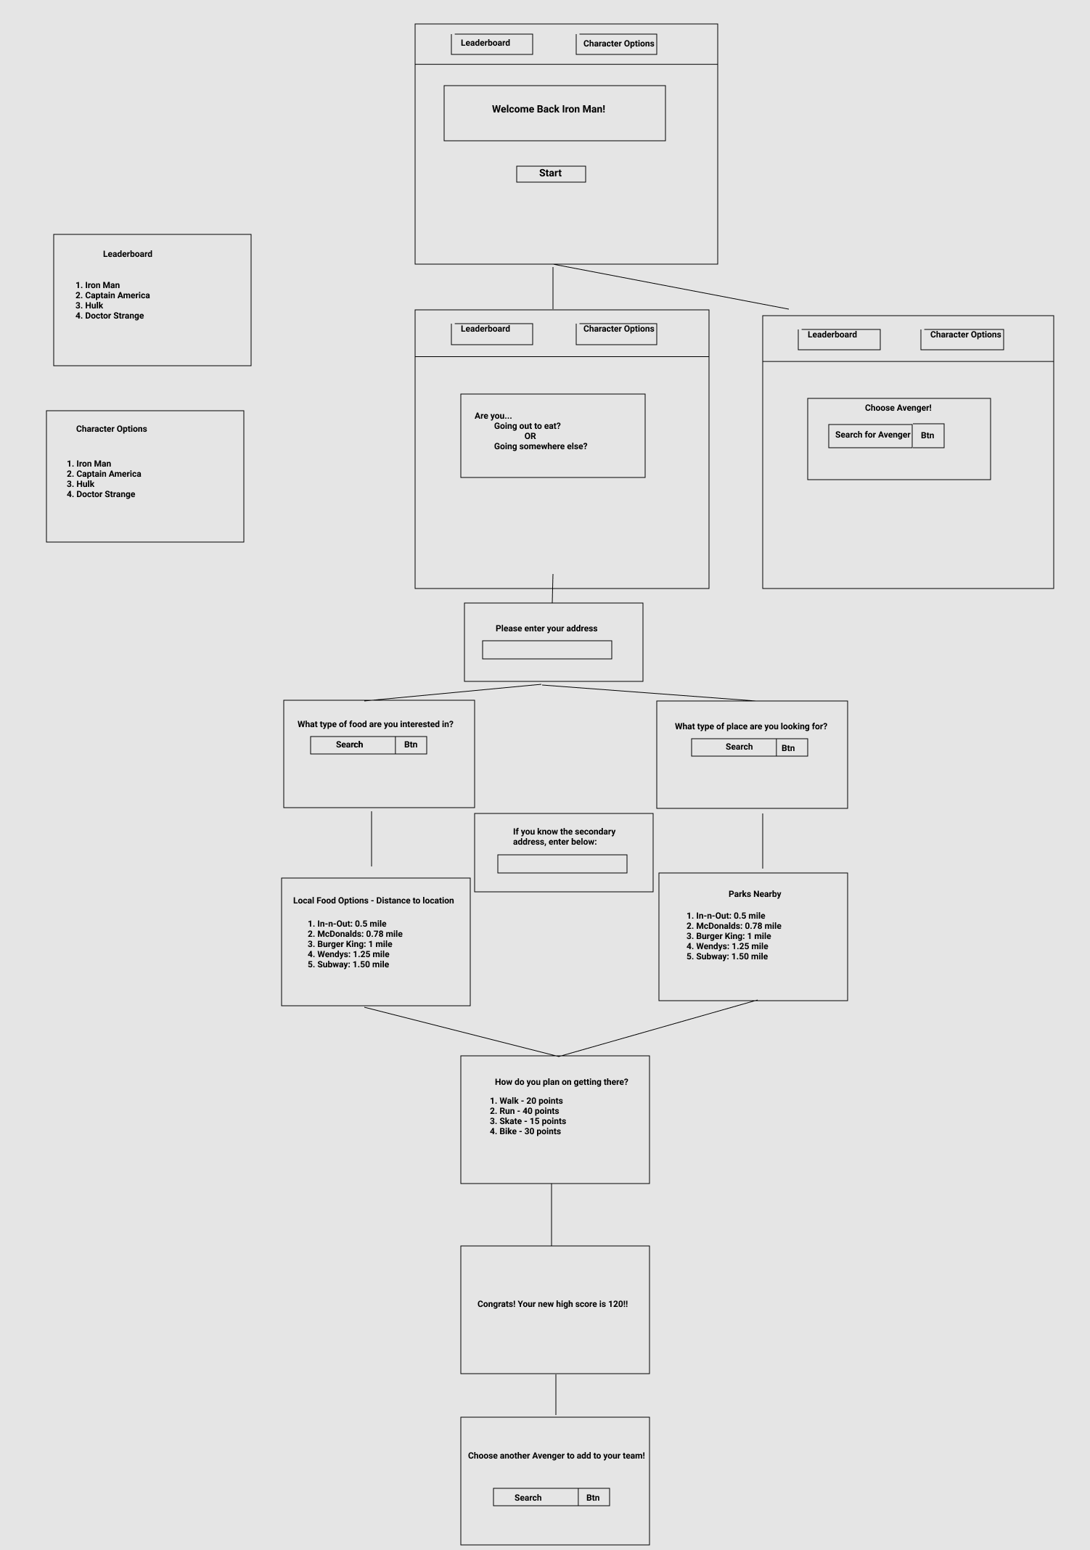
Wireframe
User Experience

Slide 13

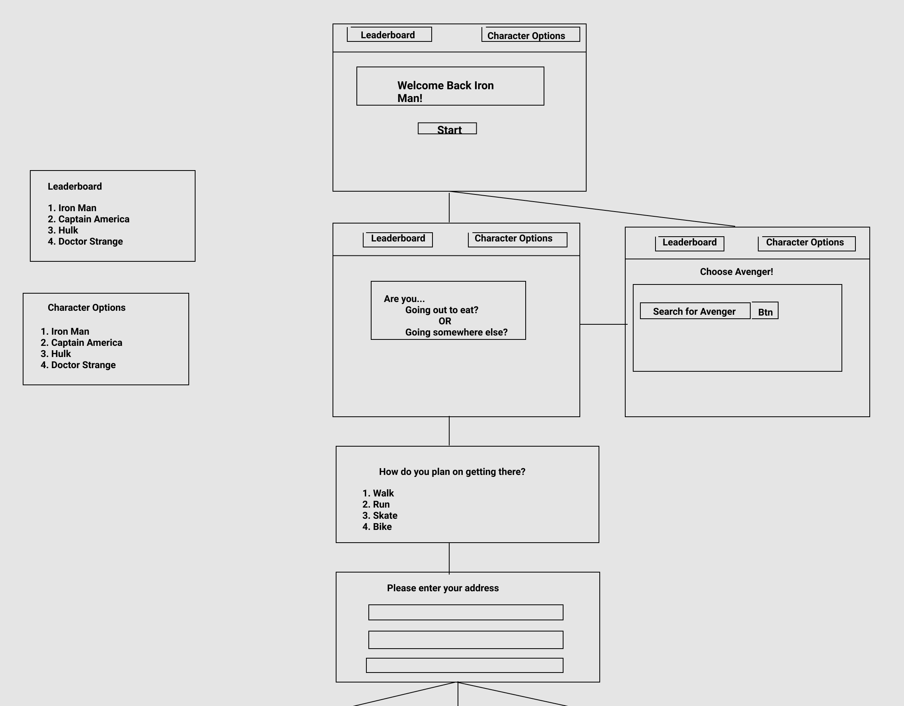
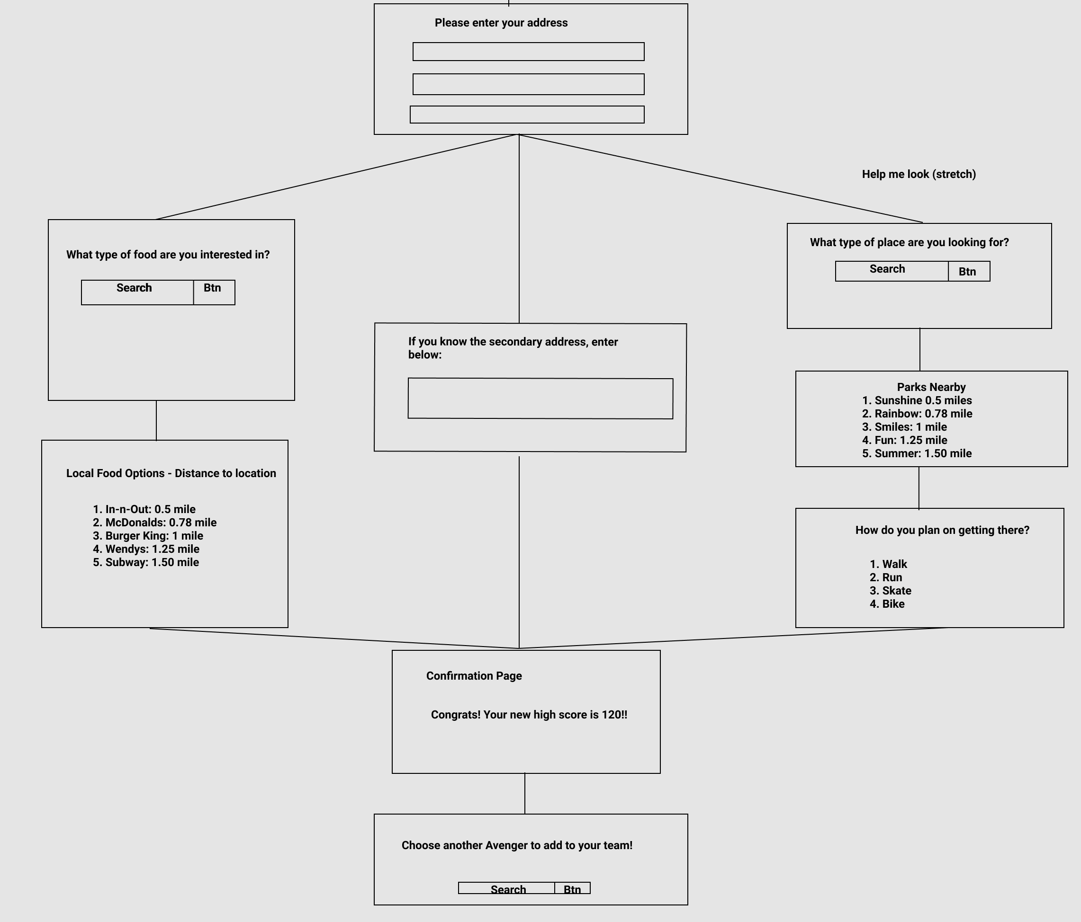
Wireframe cont...

Slide 14
Code Sections
| User Account | Interactivity |
| APIs & Libraries | Key Functions |
Gabe Sucich

Slide 15
Code Modules
Geocoder and OpenRoute APIs
Converts addresses to geocoordinates.
Route distance calculated from geocoordinates`of starting point and destination are
User Profile:
Stores user profile information in local storage
Stores user score in local storage
Sends any addresses input by use
Sends new points to update score
Geocoder and Zomato Restaurant
Converts current address to geocoordinates.
Finds nearby restaurants matching search query.
User Interaction:
Prompts the user about the nature of activity
Stores locations in local storage for future reference
Stores algorithm for calculating points earned
Sends user address and food preferences

Slide 16
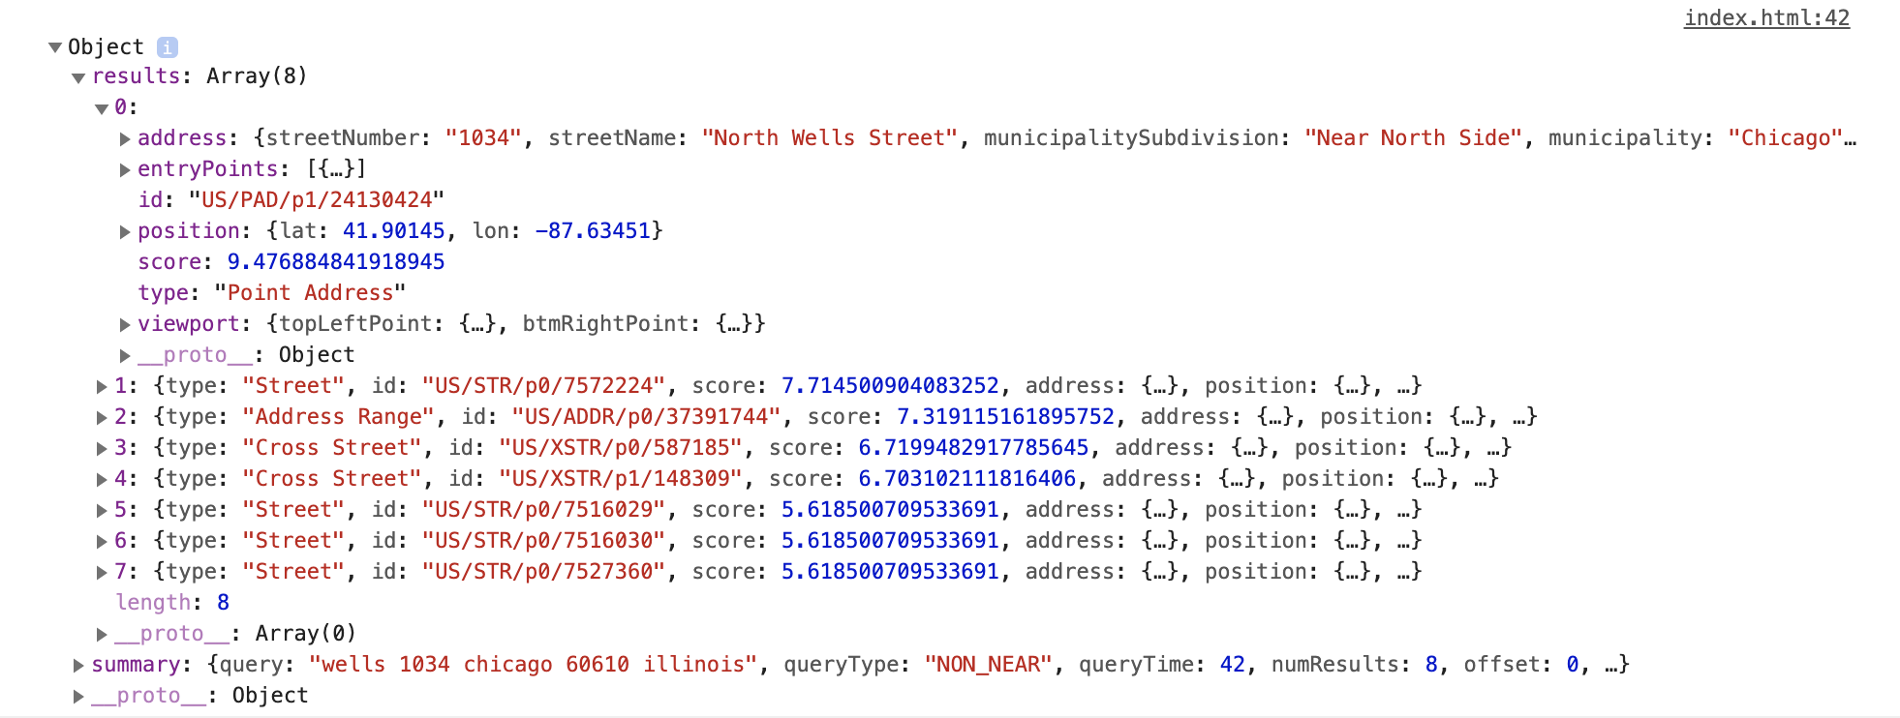
TomTom Geocoder API
https://api.tomtom.com/search/2/structuredGeocode.JSON?key=[api_key]&[address_info]

Slide 17
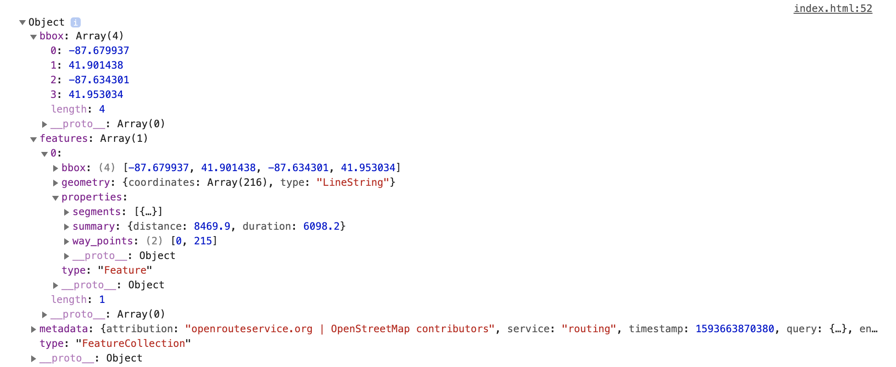
OpenRoute API
https://api.openrouteservice.org/v2/directions/foot-walking?api_key=[api_key]3&start=[coordinates]&end=[coordinates]

Slide 18
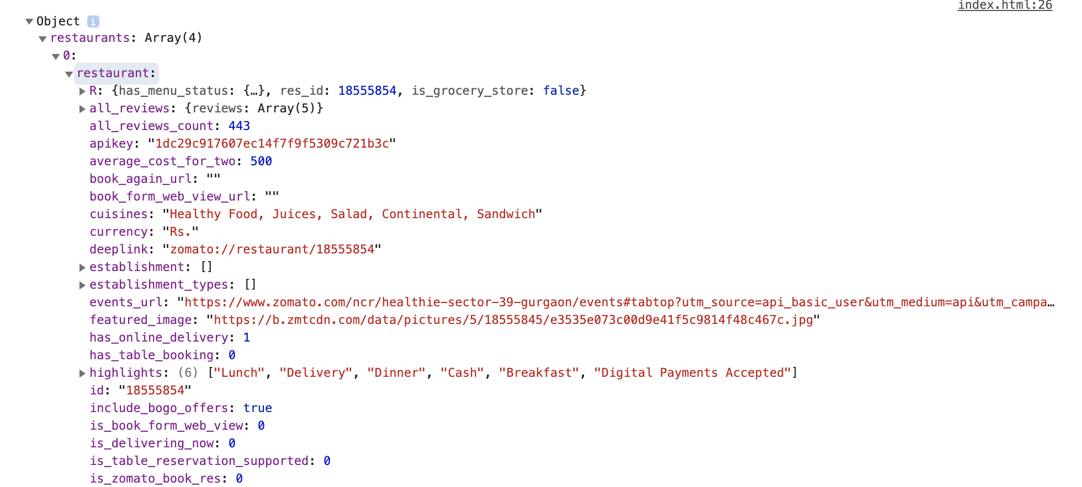
Zomato API
https://developers.zomato.com/api/v2.1/search?q=[food_query]&lat=[lat]&lon=[lon]&radius=[miles]

Slide 19
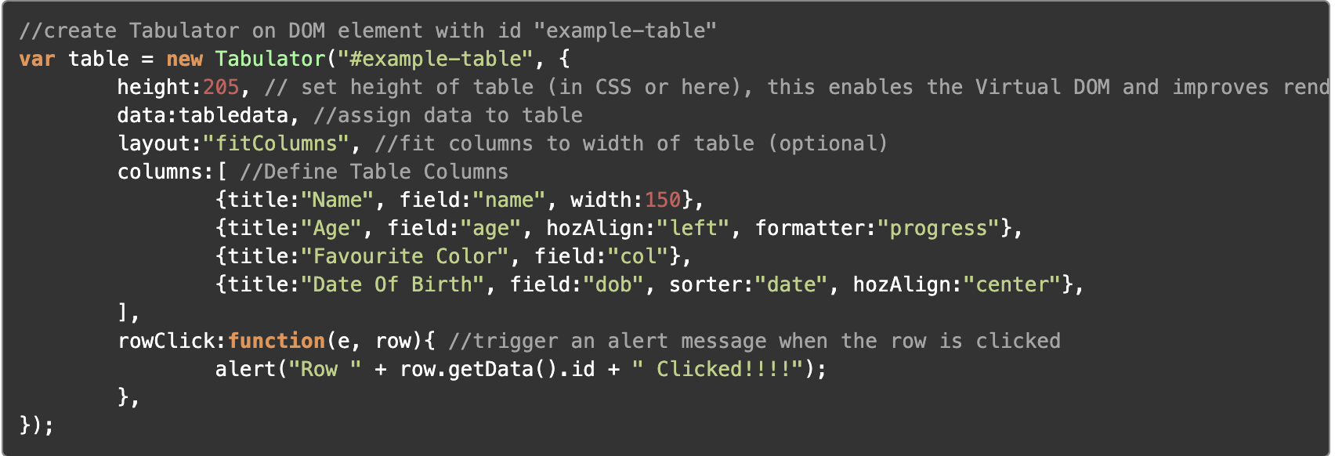
Tabulator

Slide 20
Tabulator

Slide 21
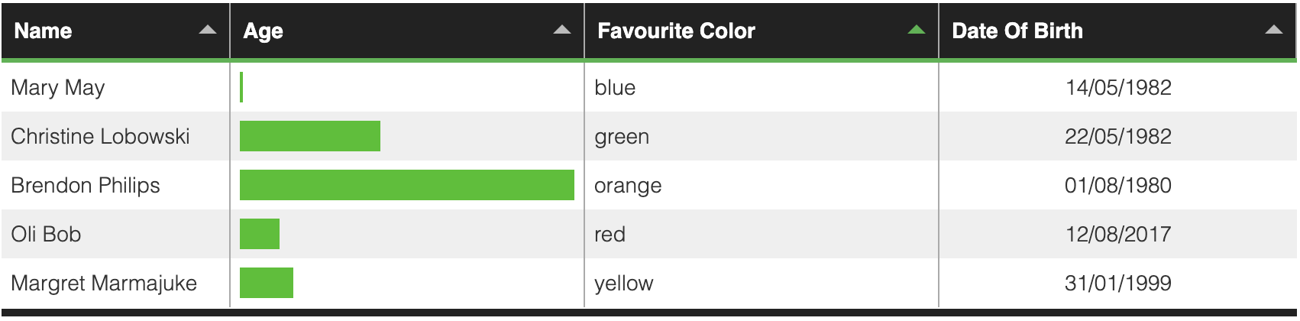
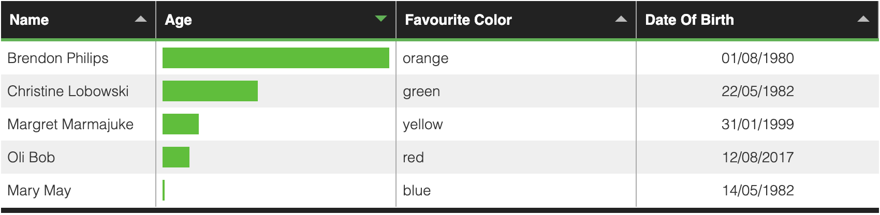
Tabulator

Slide 22
Intro
Choose one approach
Unexpected Highlight what’s new, unusual, or surprising.
Emotional Give people a reason to care.
Simple Provide a simple unifying message for what is to come

Slide 23
How many languages do you need to know to communicate with the rest of the world?
Tip
In this example, we’re leading off with something unexpected.
While the audience is trying to come up with a number, we’ll surprise them with the next slide.

Slide 24
Just one! Your own.
(With a little help from your smart phone)
Tip
Remember. If something sounds like common sense, people will ignore it.
Highlight what is unexpected about your topic.

Slide 25

The Google Translate app can repeat anything you say in up to NINETY LANGUAGES from German and Japanese to Czech and Zulu
Tip
Don’t wait till the end of the presentation to give the bottom line.
Reveal your product or idea (in this case a translation app) up front.

Slide 26
2. Examples
By the end of this section, your audience should be able to visualize:
What What is the pain you cure with your solution?
Who Show them a specific person who would benefit from your solution.

Slide 27
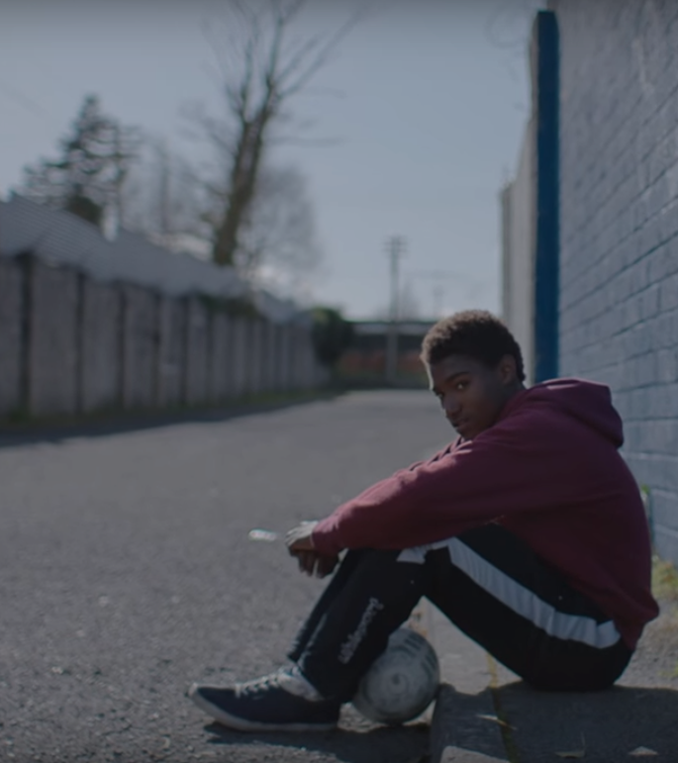
Meet Alberto.
He recently moved from Spain to a small town in Northern Ireland.
He loved soccer, but feared he had no way to talk to a coach or teammates.
Tip
Tell the audience about the problem through a story, ideally a person.

Slide 28

Meet Marcos.
He recently opened a camera shop near the Louvre in Paris.
Visitors to his store, mostly tourists, speak many different languages making anything beyond a simple transaction a challenge.
Tip
If one example isn’t sufficient to help people understand the breadth of your idea, pick a couple of examples.

Slide 29
A translation barrier left Alberto feeling lonely and hurt Marco’s business.
Tip
Ideally, speak of people in very different situations, but where each could benefit from your solution.

Slide 30

Then, Marcos discovered Google Translate
He has his visiting customers speak their camera issues into the app.
He’s able to give them a friendly, personalized experience by understanding exactly what they need.

Slide 31
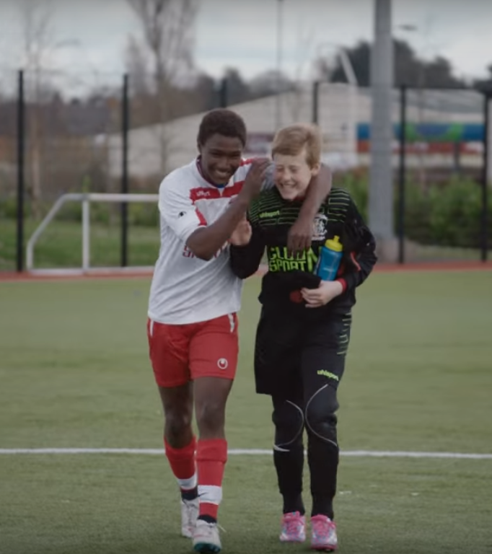
A simple gesture
Coaches Gary and Glen knew no Spanish.
They used Google Translate to invite Alberto to join in... “Do you want to play?”... “Can you defend the left side?”
Tip
Show how your solution helps the person in the story reach his or her goals.
project Miles

Slide 32

From outsider to star
Alberto scored 30 goals in 21 games. He is now being scouted by several professional clubs in the Premier League. And he’s a favorite of the other boys on the team.
See a short video on Alberto’s story
Tip
Stories become more credible when they use concrete details such as the specific complex moves Alberto learned through Translate and his 30 goals in 21 games performance stats.

Slide 33
3. Examples
People need to understand how rare or frequent your examples are.
Pick 1 or 2 statistics and make them as concrete as possible. Stats are generally not sticky, but here are a few tactics:
Relate Deliver data within the context of a story you’ve already told
Compare Make big numbers digestible by putting them in the context of something familiar

Slide 34
It’s no surprise Marcos uses Google Translate in his shop regularly.
There are 23 officially recognized languages in the EU.
Tip
Don’t let data stand alone. Always relate it back to a story you’ve already told, in this case, Marco’s shop.
Source: theguardian.com

Slide 35


More than 50 million Americans travelled abroad in 2015
THAT’S MORE THAN THE POPULATION OF
CALIFORNIA AND TEXAS COMBINED
Tip
When a number is too large or too small to easily comprehend, clarify it with a comparison to something familiar.
Source: travel.trade.gov

Slide 36
4. Closing
Build confidence around your product or idea by including at least one of the these slides:
Milestones What has been accomplished and what might be left to tackle?
Testimonials Who supports your idea (or doesn’t)?
What’s next? How can the audience get involved or find out more?

Slide 37
Milestones
October 2014
October 2015
August 2015
November 2015
Translate web pages with Chrome extension
Translate text within an app
2014 |  |  |  | 2015
Translate conversations through your Android watch
Translate written text from English or German to Arabic with the click of a camera

Slide 38
What people are saying
With this app, I’m confident to plan a trip to rural Vietnam
Wendy Writer, CA
Visual translation feels like magic
Ronny Reader, NYC
Translate has officially inspired me to learn French
Abby Author, NYC
Quotes for illustration purposes only

Slide 39

Know a 2nd language? Make Google Translate even better by joining the community.
Tip
Inspire your audience to act on the information they just learned.
Depending on your idea, this can be anything from downloading an app to joining an organization.

Slide 40

Good luck!
We hope you’ll use these tips to go out and deliver a memorable pitch for your product or service!
For more (free) presentation tips relevant to other types of messages, go to heathbrothers.com/presentations
For more about making your ideas stick with others, check out our book!

